Slide 1


WEB APPLICATION PEN-TESTING (WAPT)
Diploma in CSF
Academic Year (AY) 22/23 – October `22
Week 1.1
Environment Setup
Last Updated: 17/10/2022

Slide 2
Learning Outcomes
At the end of this session, the learners are expected to be able to
demonstrate the skill to make use of VMware Workstation Player to setup a web application pen-testing environment for use in the subsequent lessons.

Slide 3
Contents
Download and install VMWare Workstation Player
Download and open Kali Linux VM
Download and open OWASP-Broken Web Applications v1.2 VM
Access Web Applications in OWASP-BWA VM using Kali Linux VM
Challenge 1.1

Slide 4
Download and install VMWare Workstation Player

Slide 5
Download and install VMWare Workstation Player
You can download the player from the URL given below:
https://www.vmware.com/asean/products/workstation-player/workstation-player-evaluation.html
It is free of charge for your personal use.
Double click on the file to install the player by follow the instructions and default setting to complete the installation.

Slide 6
Download and open Kali Linux VM

Slide 7
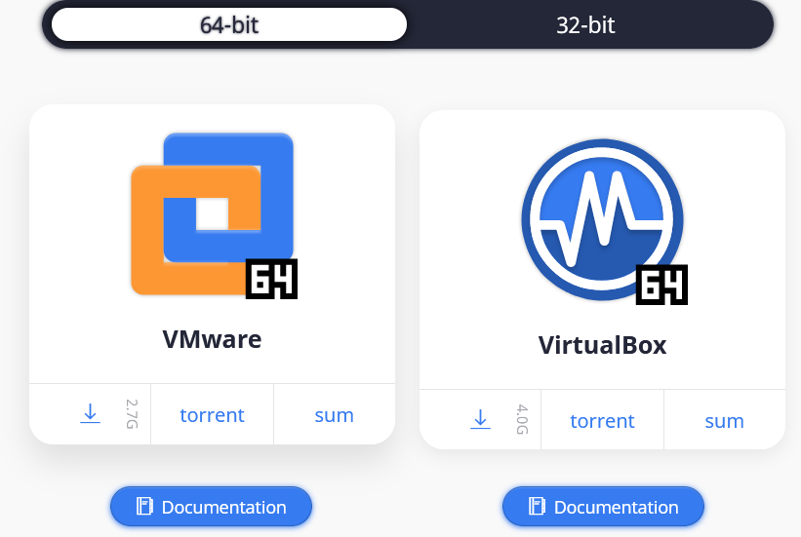
Download Kali Linux VM
Follow the URL given below to download a copy of Kali Linux that we have prepared for you.
Alternatively, you can challenge yourself by downloading Kali Linux and open it yourself. It is easy and always good to try!
https://www.kali.org/get-kali/#kali-virtual-machines
Click here

Slide 8
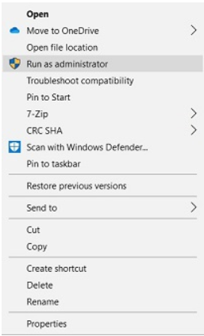
Start VMWare Workstation Player
Unzip the downloaded Kali-Linux folder
Right click on the "VMware Workstation Player shortcut" on the Desktop and select "Run as administrator".

Slide 9
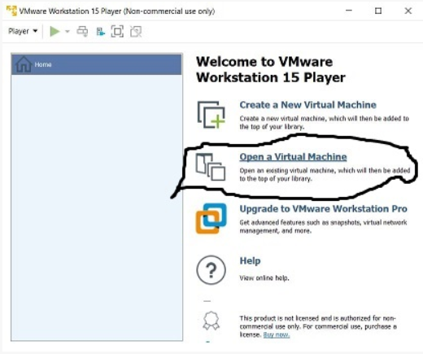
Open Kali Linux VM
Click on "Open a Virtual Machine", change the directory to the unzipped folder where the Kali Linux VM files are located.

Slide 10
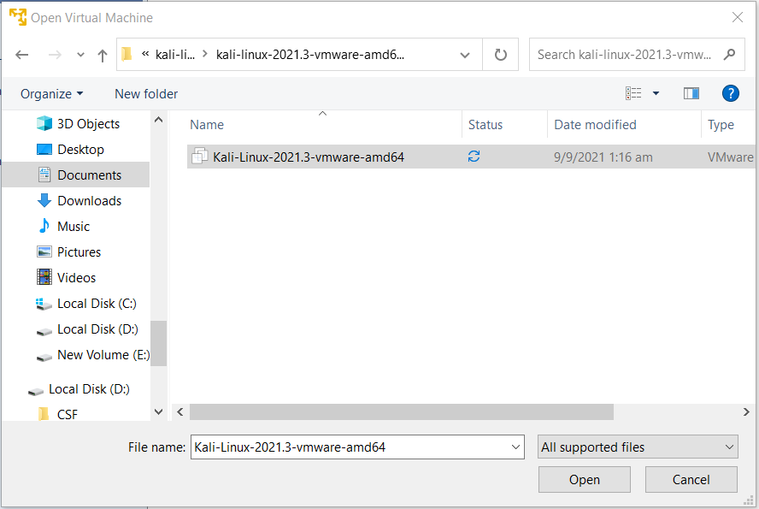
Load the .vmx configuration file for Kali-Linux. ".

Slide 11
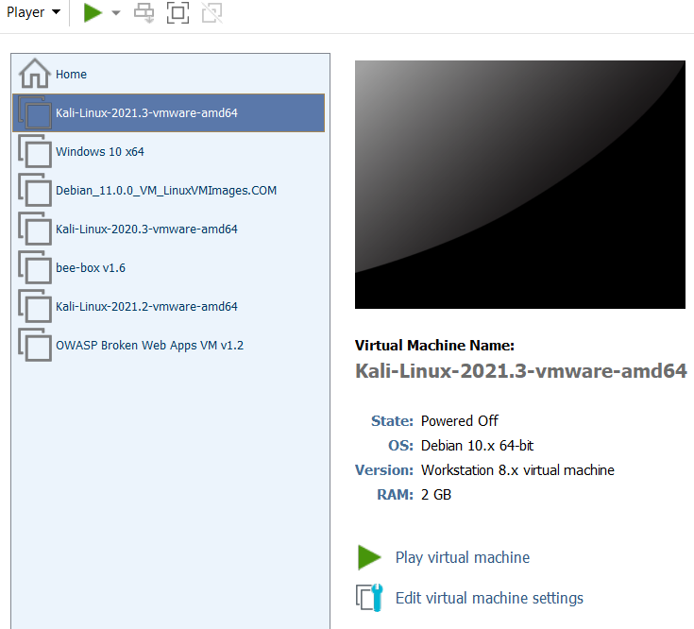
The following screen will appear. Click on [Play virtual machine] option to continue...

Slide 12
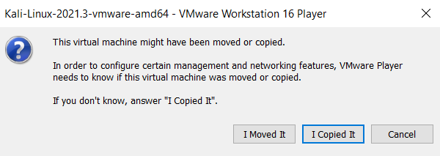
You will be asked the following, click on [ I Copied It ] to continue ..

Slide 13
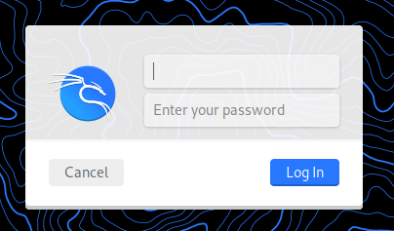
Follow the default setting (if any) till you see the login screen as follow:
Enter "kali" as username and "kali" as the password to continue...

Slide 14
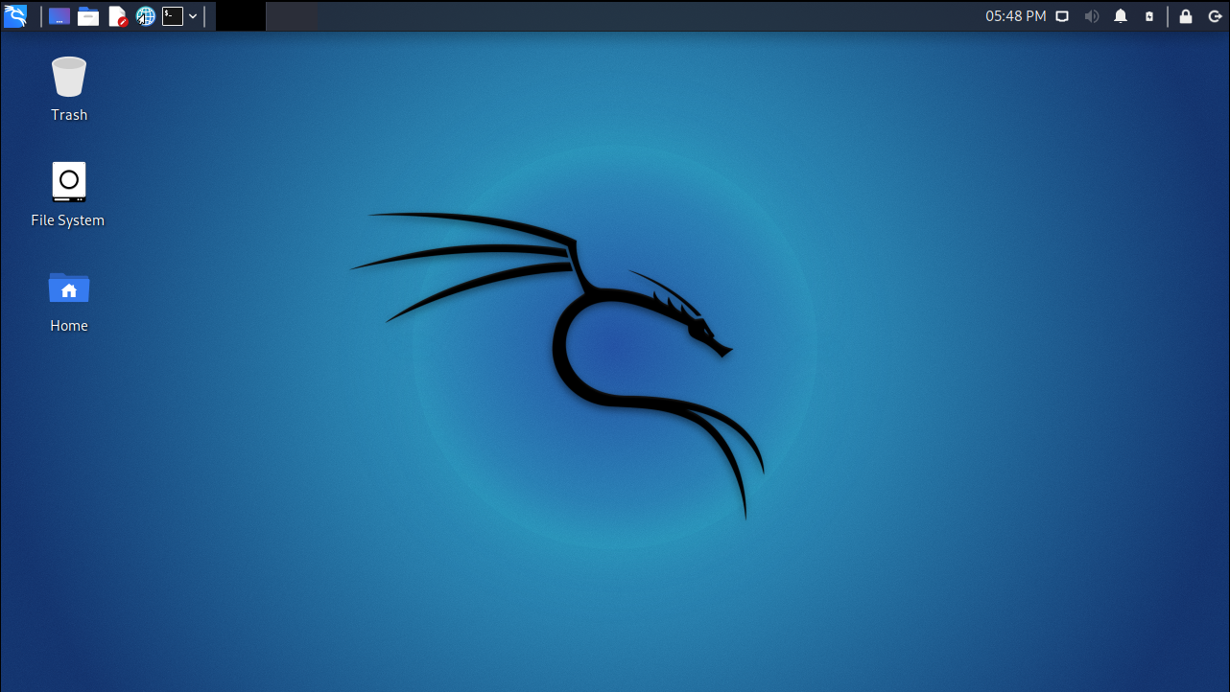
Once the OS is loaded, the following screen will appear...

Slide 15
Download and open OWASP-Broken Web Applications v1.2 VM

Slide 16
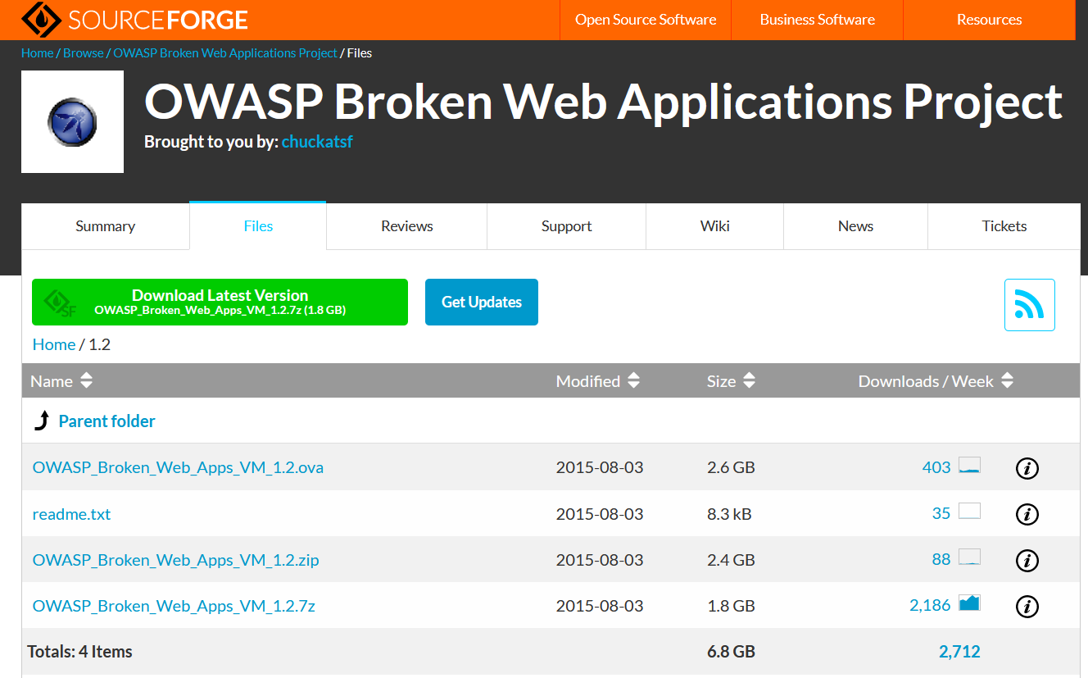
Download OWASP Broken Web Application(VWA) VM
You can download a copy of BWA at
https://sourceforge.net/projects/owaspbwa/files/1.2/

Slide 17
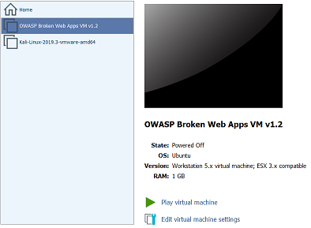
Open OWASP-BWA VM
Unzip the OWASP-BWA VM
Open the VM like you have opened Kali-Linux VM
Click on [Edit virtual machine settings] to view the setting.

Slide 18
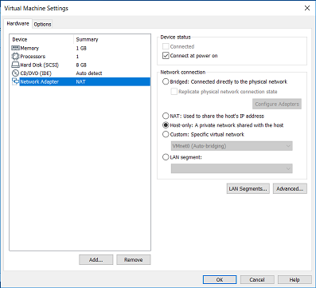
View VM Settings…
Select [Network Adaptor] and under Network Connection, notice that the Option is Host-only.
click [OK] to continue..

Slide 19
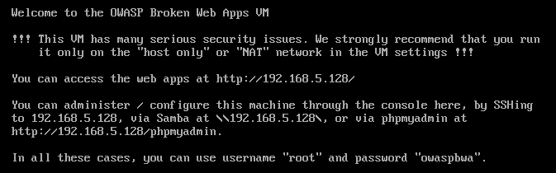
Start the OWASP-BWAS VM
Play the VM, you will see the screen like the one below:

Slide 20
What is the IP Address of the VM and Login Credential?
Note the IP address Login using the username and password provided
To access the web applications in the OWASP-BWA VM, the Kali-Linux need to be on the same subnet.

Slide 21
Access Web Applications in OWASP-BWA VM using Kali Linux VM

Slide 22
Change the Network Setting for Kali-Linux VM
Switch to Kali-Linux VM and on the VM menu, select [Player] [Manage][Virtual Machine Setting]

Slide 23
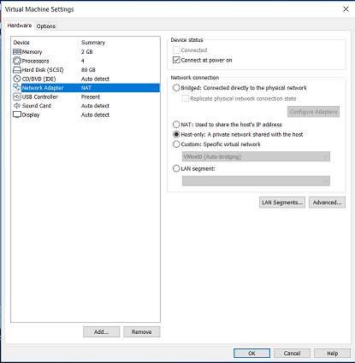
Change the Network Setting for Kali-Linux VM
Select "Network Adaptor" and under Network Connection
Choose Host-only option, it is used to connect to OWASP-BWA VM so that Kali-Linux will received an IP of the similar subnet.

Slide 24
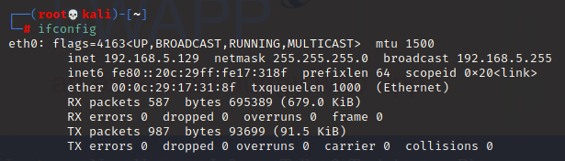
Check the IP of Kali-Linux using the “ifconfig” command in terminal.
If the IP is not on the similar subnet as the OWASP-BWA, reboot the VM to continue…

Slide 25
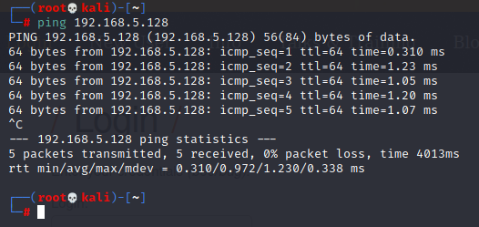
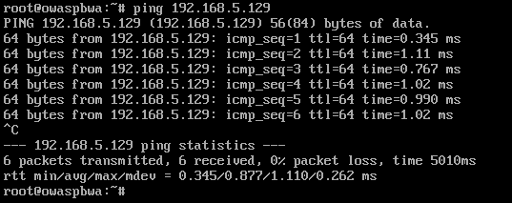
Open up a network terminal, check the IP Address again.
You should get a IP address on the similar subnet as the OWASP-BWA. If not, contact your peers or tutor for help.
If yes, check the connectivity between the two VMs using the ping command.

Slide 26
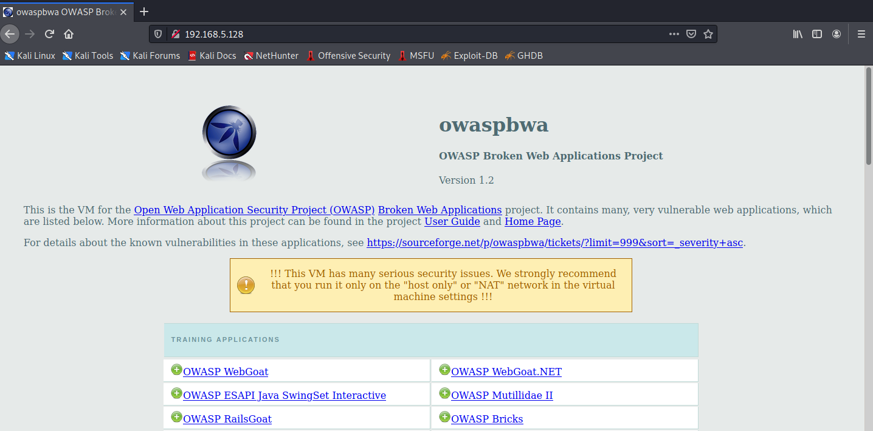
Access the Web Applications provided by OWASP-BWA VM

Slide 27
Challenge 1.1

Slide 28
Introduction
There are many useful free resources on learning web applications penetration testing available on the Internet.
However they are everywhere, some are outdated, some are too brief, some are too long winded, some are not working and some are in foreign languages.
Couple with the basic knowledge and skills, a good pen-tester would be able to select, filter and make use of these resources to achieve what he/she is set off to do.
This challenge set you off to search through the Internet for a publicly available virtual machine called BeeBox that we will be using for learning the various OWASP Top 10 Web Vulnerabilities.
No submission is needed for this challenge.

Slide 29
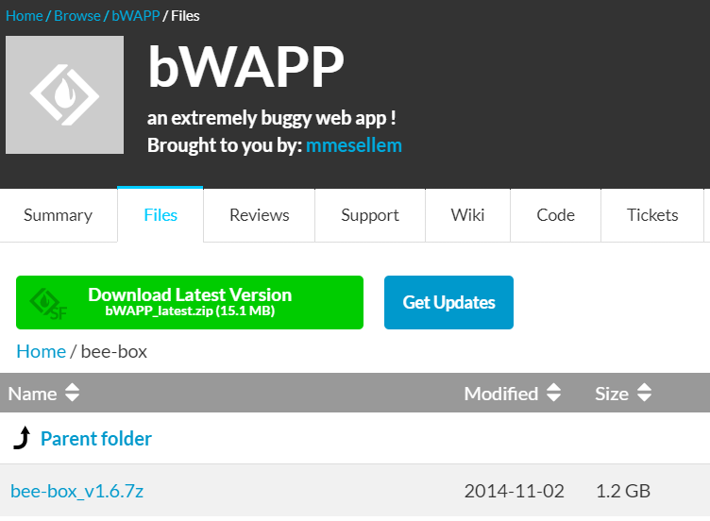
Task 1 - Download BeeBox VM and Open it using the VMWare Player
Find BeeBox 1.6 VM

Slide 30
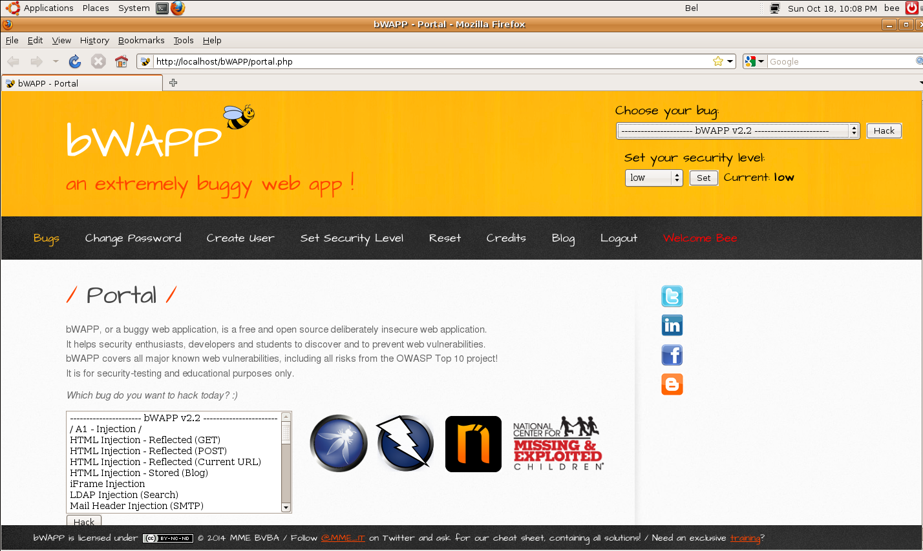
Download and Open it using VMPlayer

Slide 31
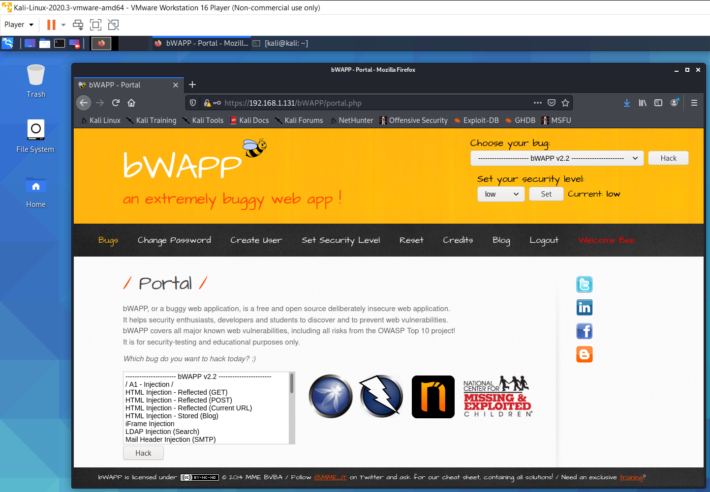
Task 2 - Open your BeeBox website in Kali Linux
Start your Kali Linux VM and use the default bowser and point the URL to the BeeBox Web-site in the VM you have setup in Task 1.

Slide 32
End of
Session 1.1

